Slide 1


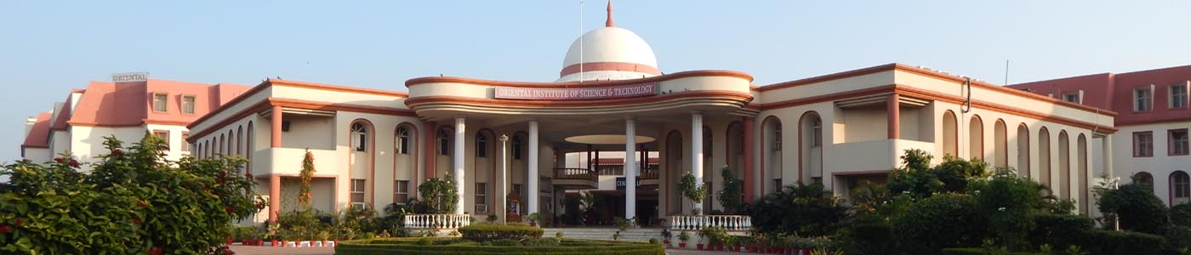
Oriental Institute of Science and Technology
(Deptt. Of Computer Applications)
(RAJIV GANDHI PROUDYOGIKI VISHWAVIDYALAYA)
BHOPAL (M.P.)
MAJOR PROJECT REPORT ON
“House Of Mandi”
SUBMITTED FOR PARTIAL FULLFILMENT OF THE REQUIREMENT FOR
MASTER OF COMPUTER APPLICATIONS
SUBMITTED TO -:
Jan. to May - 2019
SUBMITTED BY-:
Prof. Sandeep Monga
Sanjay Kumar Aditya Narayan
0105CA161006 0105CA173D05
HOD-MCA

Slide 2
Contents
TITLE
INTRODUCTION OF PROJECT
MODULES
COMPANY PROFILE
Technology & Methodology used
DFD (LEVEL 0,1)
TABLES
FORMS
REPORTS
CONCLUSION AND FUTURE SCOPE
REFERENCES

Slide 3
Description
House of mandi is an android app which features variety of food and spices. With the core concept of the system remains for the convenience for the customers, online food startups do not control food quality. Our mission is dedicated to the freshest delivered with the highest level of customer service. It’s also manage the details of Food, Item Category, Cart, Customer, Order. It manages all the information about the Food, Delivery Address, orders. With people now wanting everything to be delivered at doorstep, delivery has become the major segment of food industry. To stay ahead of competitors, we need to be loaded with technology, demanding a strong presence on mobiles and web.

Slide 4
MODULES OF THE PROJECT
1) Admin
2) Customer
******************* LIST OF CUSTOMER ACTIONS *******************
1) Customer Registration (Verification via Email : Login Allowed Only on approval of Admin)
2) Customer Login and Logout
3) Customer Profile Management (Change Password , Forgot Password , Profile Deletion)
4) Category-wise Display Of Menu Items (categories such as drinks , main_course , salads etc.)
5) Quantity Selection Option for each Food Item
6) Options for buying (Buy Now , Add To Cart)
7) Order History Section (List of ordered items , Placed Order Status)

Slide 5
****LIST OF ADMIN ACTION****
1) Admin Login and Logout
2) Admin Profile Management(Change Password , Forgot Password)
3) Approval For Requesting VIP Customers
4) Food Items Management (Addition, Updation and Deletion Of Food Items)
5) Food Category Management (Addition, Updation and Deletion Of Food Categories)
6) Coupon Management (Addition, Updation and Deletion Of Food Coupons)
7) Registered VIP Customers Section
8) Received Orders Section
9) Received Orders Status Management (Changing Status Of Orders)
10) Weekly , Monthly and Yearly Reports For Completed Orders

Slide 6
-----PHASE I -------
Customer Actions:-
1) Customer Registration (Verification via Email : Login Allowed Only on approval of Admin)
2) Customer Login and Logout
3) Customer Profile Management (Change Password , Forgot Password , Profile Deletion)
4) Category-wise Display Of Menu Items (categories such as drinks, main_course , salads etc.)
5) Quantity Selection Option for each Food Item
6) 2 options for buying (Buy Now , Add To Cart)
7) Order History Section (Placed Order Status)
Admin Actions:-
1) Admin Login and Logout
2) Admin Profile Management(Change Password , Forgot Password)
3) Approval For Requesting VIP Customers
4) Food Items Management (Addition, Updation and Deletion Of Food Items)
5) Food Category Management (Addition, Updation and Deletion Of Food Categories)
6) Registered VIP Customers Section
7) Received Orders Section
8) Received Orders Status Management (Changing Status Of Orders)

Slide 7
-----PHASE II-----
Customer Actions:-
1) Order History Section (List of ordered items , Review and Rating for ordered items , Review Sharing On Social Media)
Admin Actions:-
1) Weekly , Monthly and Yearly Reports For Completed Orders

Slide 8

Company Profile
Industrial Training
On JavaJ2EE ,Spring and Hibernate
At Ypsilon It Solution Pvt. Ltd. Indore
Ypsilon is Software Development Company ,It has been more than 27 year of this company ,there are 55 developers are working and the owner of universal informatics is same so technology part is completed by universal informatics and projects is given by Ypsilion Solutions pvt.Ltd.
The Director of the Company is Kishore Bhuradiya.
It is private Company.
The Company Category is limited Shares.
This provides training in various technologies JAVA,DOT NET,ANDROID,PYTHON ,PHP, IOS etc.

Slide 9
Technology & Methodology used
Hardware Specification(Minimum):
Device : Android Smart Phone
RAM : 512MB or Above
Internal Space : 1GB or Above
Processor : Quad - core or above
Software Requirement:
Tools : Android Studio, Java Development Kit 8.0 (JVM and JRE)
(NetBeans ,Apache Tomcat server)
OS : Android or Any other.
Technology Used-
Language: ANDROID
Front End:-
Android
Back End :-My SQL and JSP

Slide 10
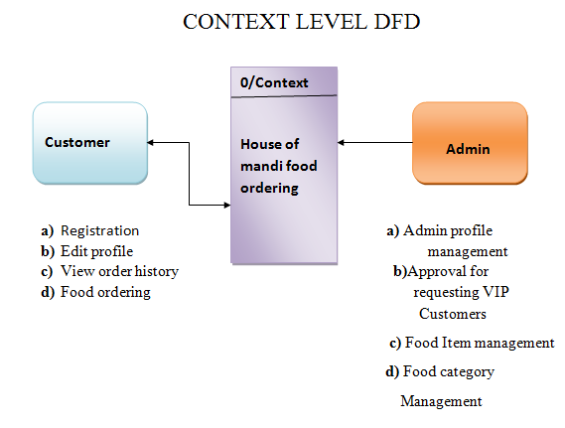
Dfd (level 0,1)
CONTEXT LEVEL DFD:-

Slide 11
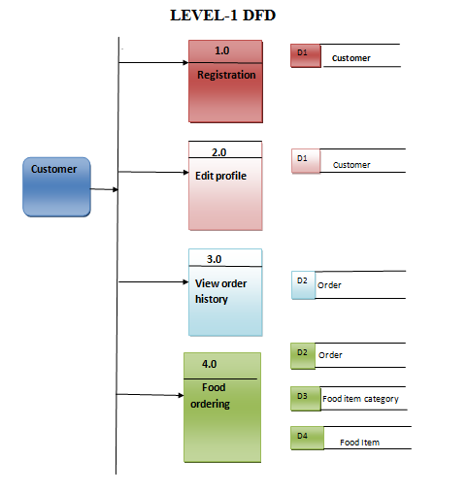
LEVEL-1 DFD (customer)

Slide 12
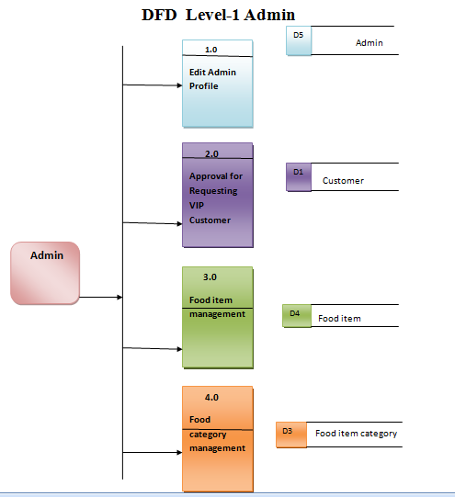
LEVEL-1 DFD (admin)

Slide 13
E-R diagram
The entity Relationship Diagram (ERD) depicts the relationship between the data objects. The ERD is e notation that is used to conduct the date modeling activity the attributes of each data object noted is the ERD can be described resign a data object descriptions.
The set of primary components that are identified by the ERD are :
· Data object
· Relationships
· Attributes
· Various types of indicators

Slide 14
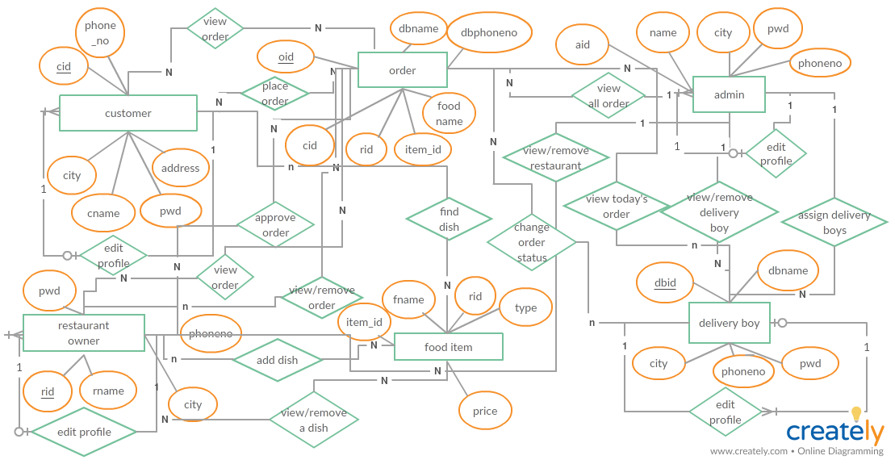

Slide 15
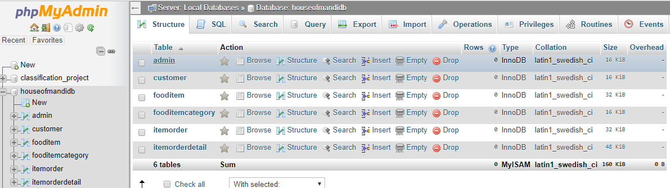
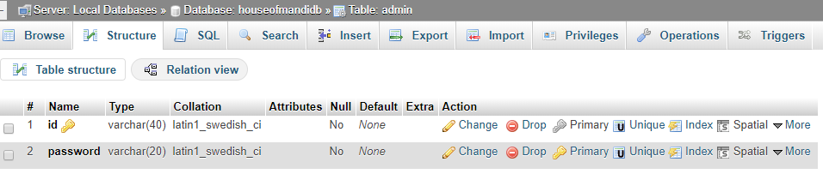
DATABASE TABLES

Slide 16
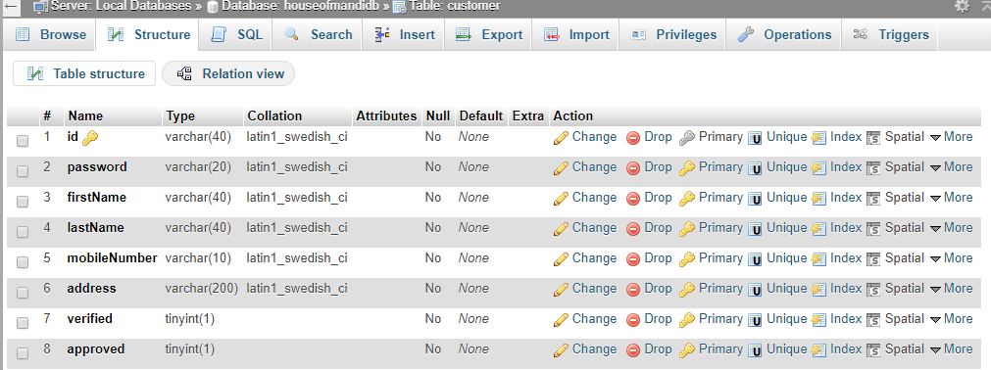
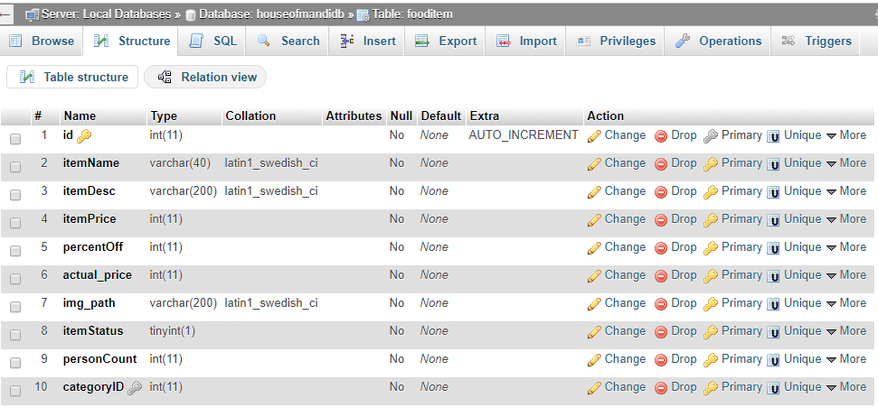

Slide 17
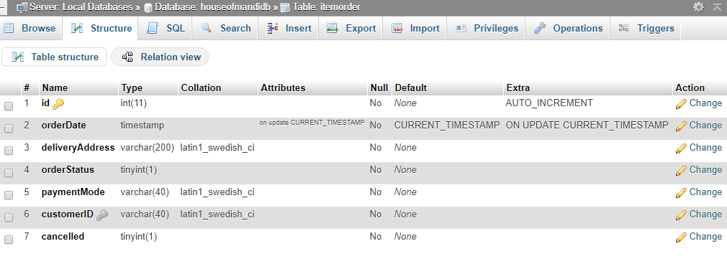
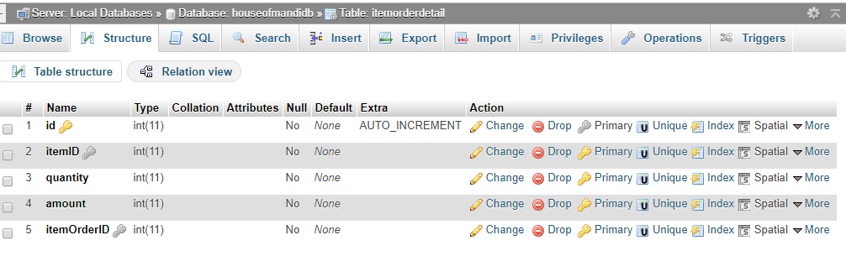

Slide 18
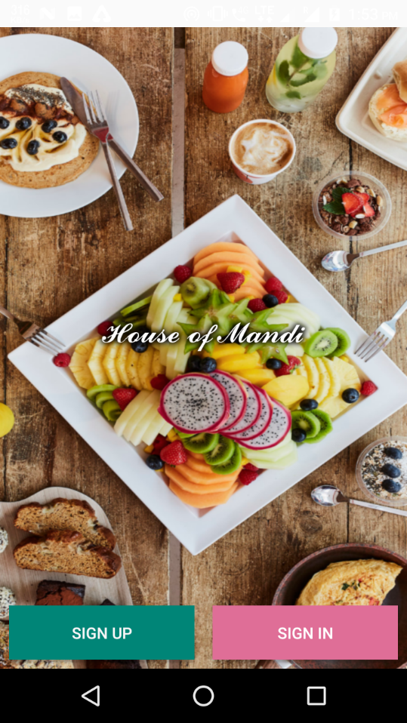
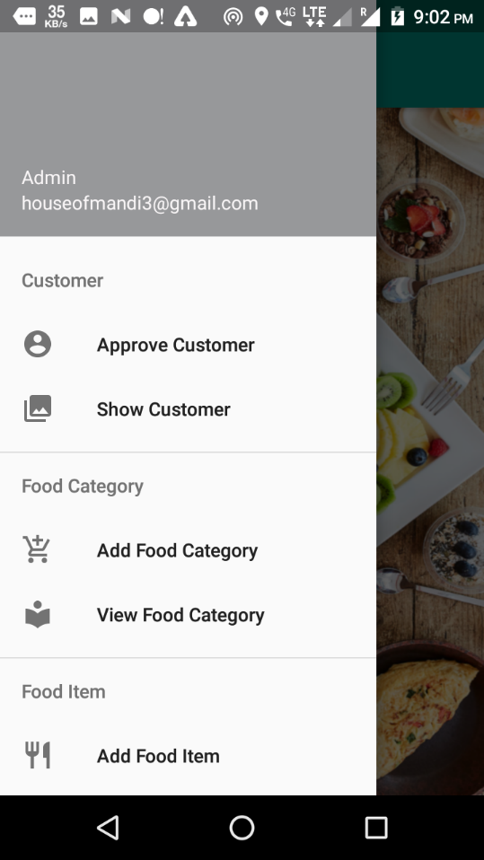
Snapshot
HOME PAGE:-

Slide 19
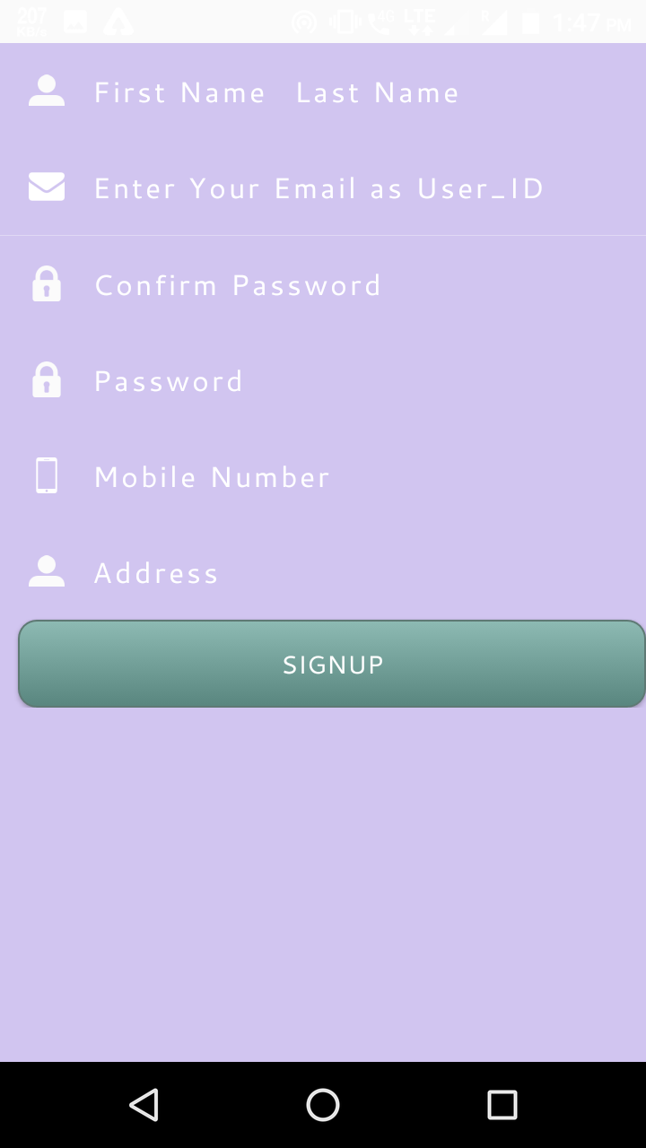
REGISTRATION PAGE:-

Slide 20
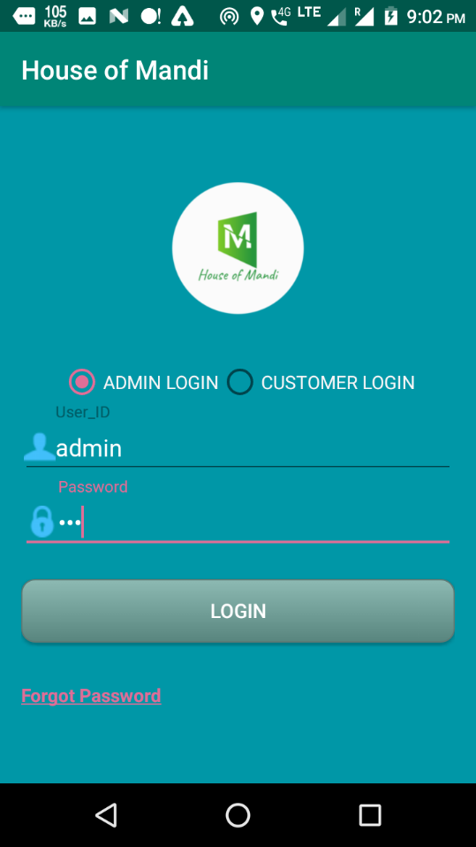
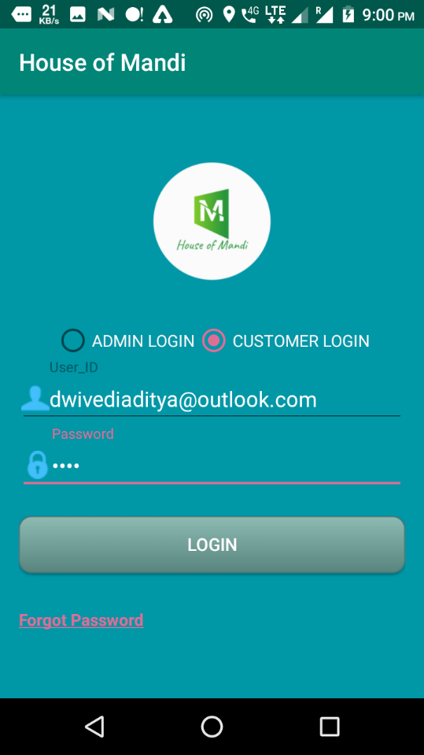
LOGIN PAGE:-

Slide 21
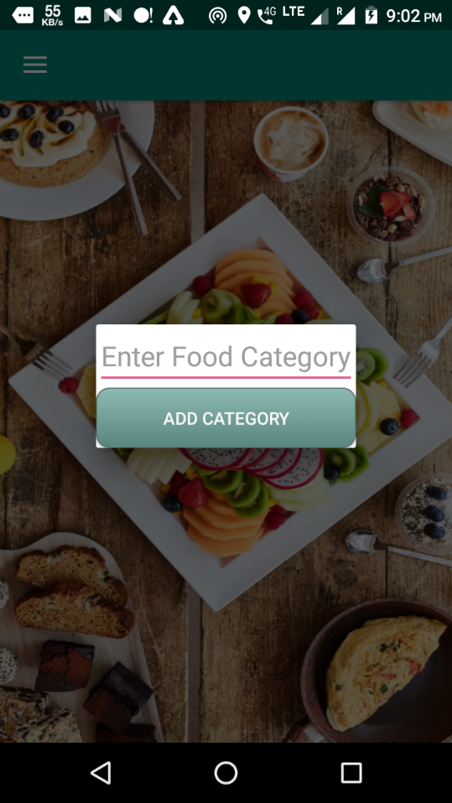
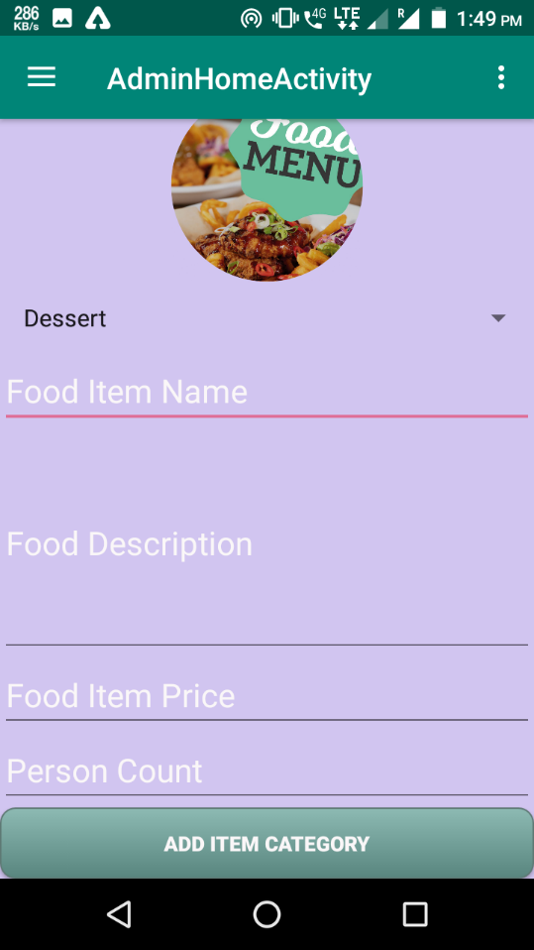
Add food category and items:-

Slide 22
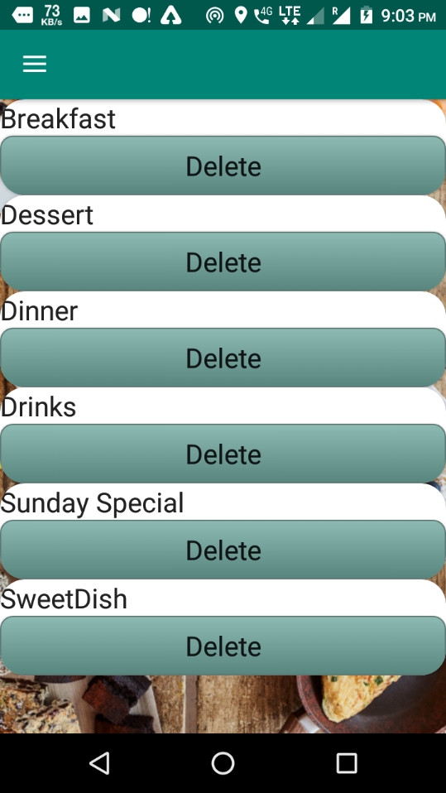
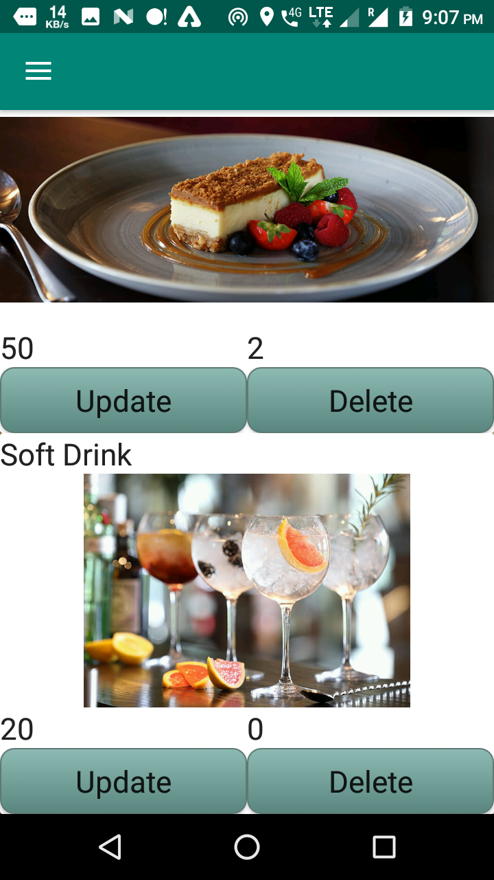
View food category and items: -

Slide 23
Future Scope:
In future this application used for multiple restaurant or hotels.
In future every personal can order food.
In future for payment wallet or upi transaction will be added.
Conclusion:
House of mandi project developed by using android, java as front end and jsp, MySQL server for database in back end to computerize the process for check in and out system.
The project covers only the basic required to sum up, developing a information system on “House Of Mandi ” for was a matter of essence.

Slide 24
Bibliography
Android mother site @ www.android.com.
Android Developers @ developer.android.com.
Android API Documentation @ http://developer.android.com/reference/packages.html.
Professional Android 4 Application Development by Reto Meier
Programming Android Java Programming for the New Generation of Mobile Devices by Zigurd Mennieks

Slide 25

(Master in Computer Applications)
Thanks for your attention !

